Slide 1
ECONOMIC ANALYSIS

Slide 2
INTRODUCTION
Whether it is a business situation or a day-to-day event in somebody’s personal life, there are a large number of economic decision making involved.
One can manage many of these decision problems by using simple economic analysis.
For example, an industry can source its raw materials from a nearby place or from a far-off place. In this problem, the following factors will affect the decision:
Price of the raw material
Transportation cost of the raw material
Availability of the raw material
Quality of the raw material

Slide 3
INTRODUCTION
Consider the alternative of sourcing raw materials from a nearby place with the following characteristics:
The raw material is more costly in the nearby area.
The availability of the raw material is not sufficient enough to support the operation of the industry throughout the year.
The raw material requires pre-processing before it is used in the production process. This would certainly add cost to the product.
The cost of transportation is minimal under this alternative.

Slide 4
INTRODUCTION
On the other hand, consider another alternative of sourcing the raw materials from a far-off place with the following characteristics:
The raw material is less costly at the far off place.
The cost of transportation is very high.
The availability of the raw material at this site is abundant and it can support the plant throughout the year.
The raw material from this site does not require any pre-processing before using it for
production.
Under such a situation, the procurement of the raw material should be decided in such a way that the overall cost is minimized.
The above example clearly highlights the various components of cost that are involved in each of the alternatives of the decision-making process as well as a method of taking a suitable decision.

Slide 5
Use of Computers in Economics
Economics and finance have undergone radical changes during the Information Age both in practice and in study.
Computational economics, a convergence of computer technology and economic theory, has changed the way companies and governments assess their economies.

Slide 6
Computational Finance
Computational finance is an interdisciplinary process that incorporates elements of mathematical science, economic theory, statistics, and computer simulation and modeling. The applications for computational finance are varied, but they typically focus on investment planning and risk management.

Slide 7
Economic Forecasting
Computers are used in the creation of complex forecasting models.
As in computational finance, computer simulations and models can be used to predict how markets will change.
While no forecast is completely reliable, Current policies and models can also be quickly adapted to changing situations with new predictions

Slide 8
Online Trading and E-Commerce
The emergence of e-commerce and online trading of goods, services and stocks has considerably changed the way we do business.
Many transactions, especially those between two businesses as opposed to a business and a consumer, are now performed online, with the exchange of information and digital purchases taking place instantly.

Slide 9
Data Presentation
The presentation of statistical and financial data has evolved with the involvement of computers.
The mountains of data, which in their raw form constitute a decidedly bland list of numbers and figures, can be visually displayed with charts and graphs.
The charts convey both data and relational concepts, making the information easier to understand for anyone involved in analysis.

Slide 10
EXAMPLES FOR SIMPLE ECONOMIC ANALYSIS
The concept of simple economic analysis is illustrated using suitable examples in the following areas:
Material selection for a product
Design selection for a product
Design selection for a process industry
Building material selection for construction activities
Process planning/Process modification

Slide 11
Material Selection for a Product/Substitution of Raw Material
The cost of a product can be reduced greatly by substitution of the raw materials. Among various elements of cost, raw material cost is most significant and it forms a major portion of the total cost of any product. So, any attempt to find a suitable raw material will bring a reduction in the total cost in any one or combinations of the following ways:
Cheaper raw material price
Reduced machining/process time
Enhanced durability of the product
Therefore, the process of raw material selection/substitution will result in finding an alternate raw material which will provide the necessary functions that are provided by the raw material that is presently used. In this process, if the new raw material provides any additional benefit, then it should be treated as its welcoming feature. This concept is demonstrated with two numerical problems.

Slide 12
EXAMPLE(2.1)
In the design of a engine part, the designer has a choice of specifying either an aluminium alloy casting or a steel casting. Either material will provide equal service, but the aluminium casting will weigh 1.2 kg as compared with 1.35 kg for the steel casting.
The aluminium can be cast for Rs. 80.00 per kg. and the steel one for Rs. 35.00 per kg. The cost of machining per unit is Rs. 150.00 for aluminium and Rs. 170.00 for steel. Every kilogram of excess weight is associated with a penalty of Rs. 1,300 due to increased fuel consumption. Which material should be specified and what is the economic advantage of the selection per unit?

Slide 13
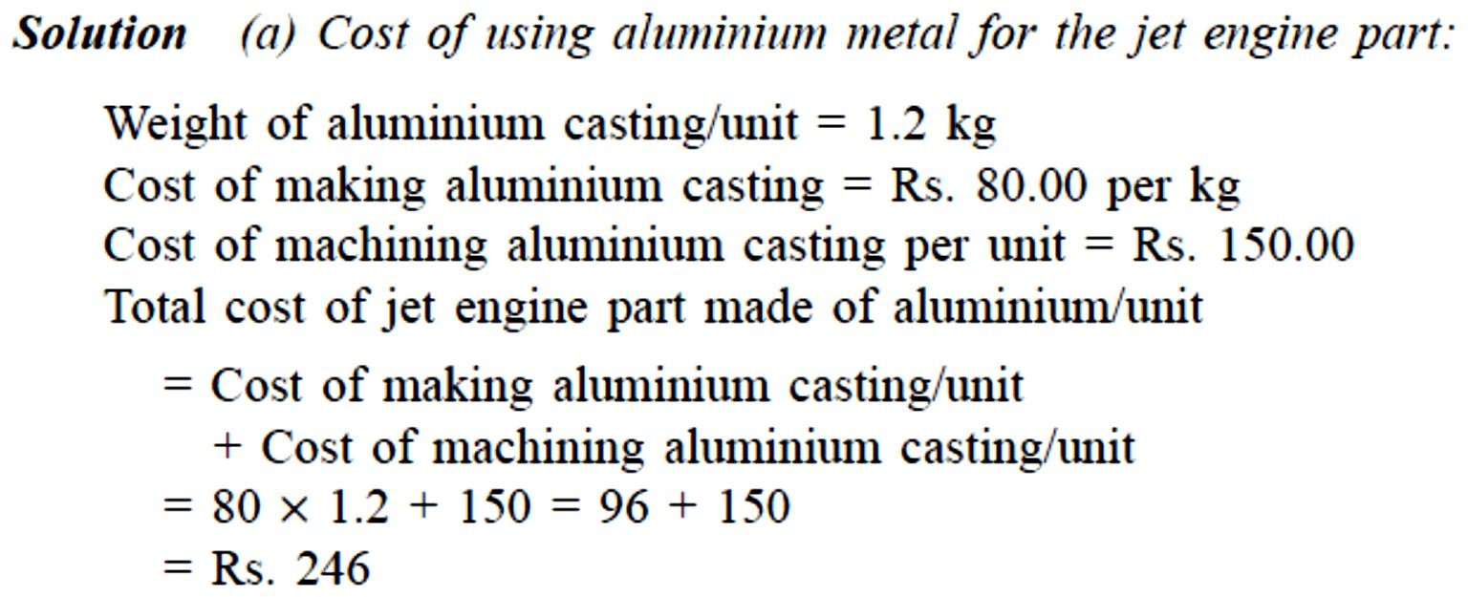
EXAMPLE(2.1)

Slide 14
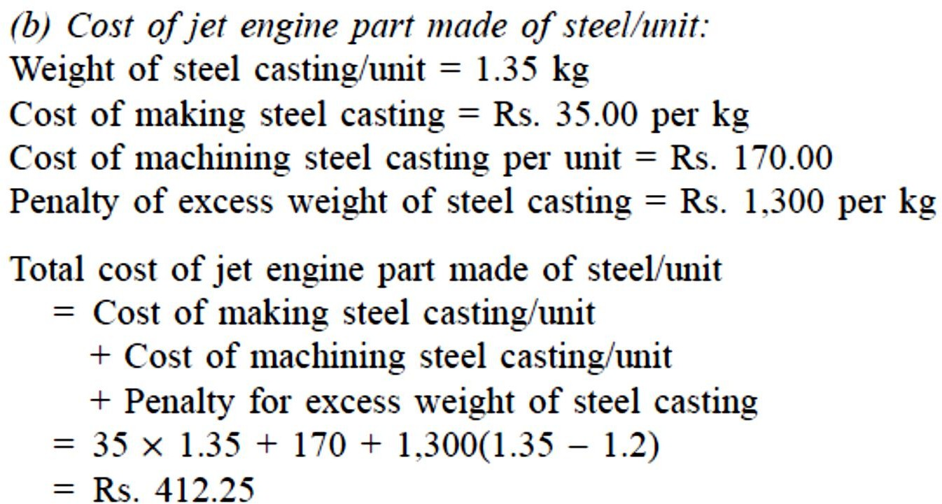
EXAMPLE(2.1)

Slide 15
EXAMPLE(2.1)
DECISION The total cost/unit of a jet engine part made of aluminium is less than that for an engine made of steel.
Hence, aluminium is suggested for making the jet engine part.
The economic advantage of using aluminium over steel/unit is Rs. 412.25 – Rs. 246 = Rs. 166.25

Slide 16
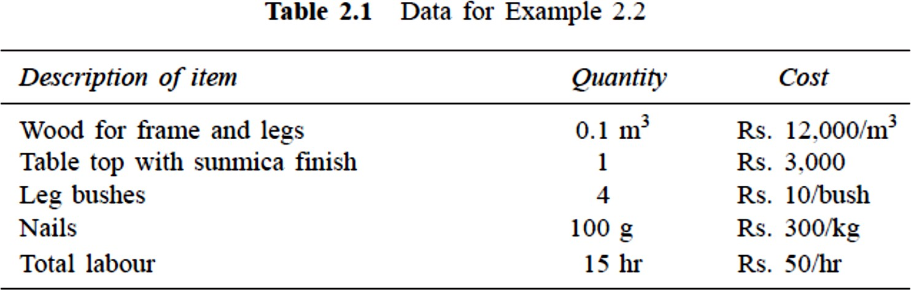
EXAMPLE 2.2
A company manufactures dining tables which mainly consist of a wooden frame and a table top.
The different materials used to manufacture the tables and their costs are given in Table 2.1.

Slide 17
EXAMPLE 2.2
In view of the growing awareness towards deforestation and environmental conservation, the company feels that the use of wood should be minimal.
The wooden top therefore could be replaced with a granite top. This would require additional wood for the frame and legs to take the extra weight of the granite top.
The materials and labour requirements along with cost details to manufacture a table with granite top are given in Table 2.2.

Slide 18
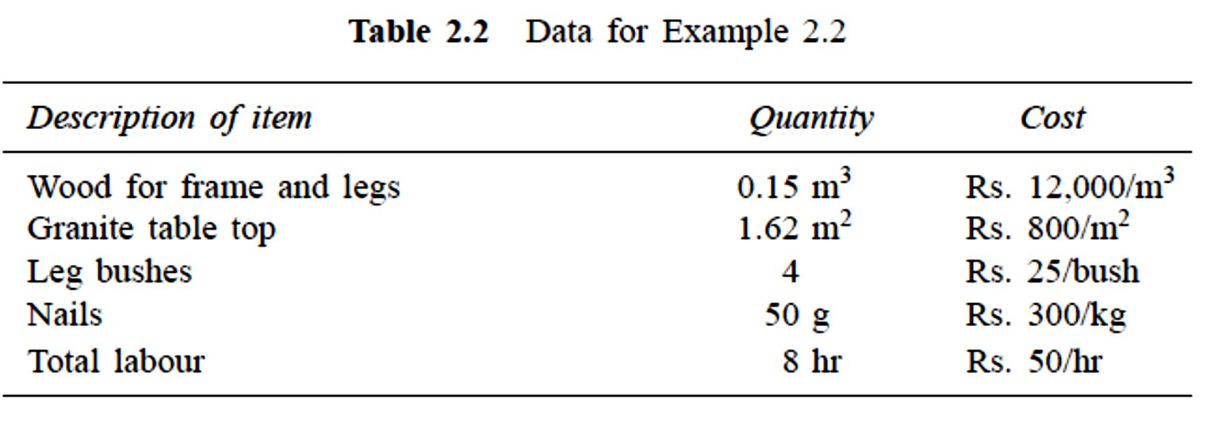
EXAMPLE 2.2
If the cost of the dining table with a granite top works out to be lesser than that of the table with wooden top, the company is willing to manufacture dining tables with granite tops.
Compute the cost of manufacture of the table under each of the alternatives described above and suggest the best alternative. Also, find the economic advantage of the best alternative.

Slide 19
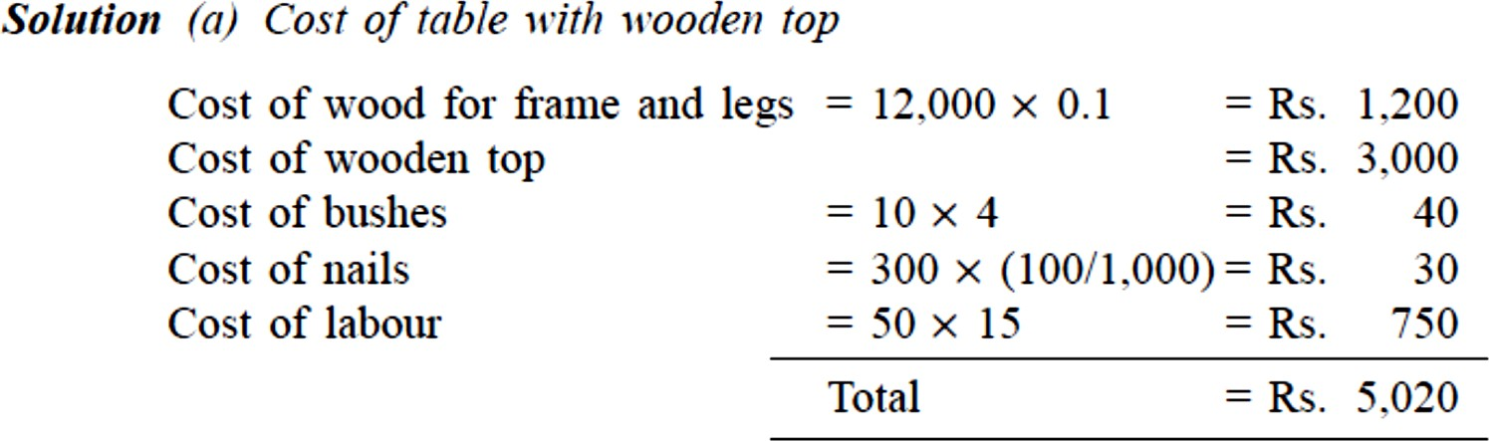
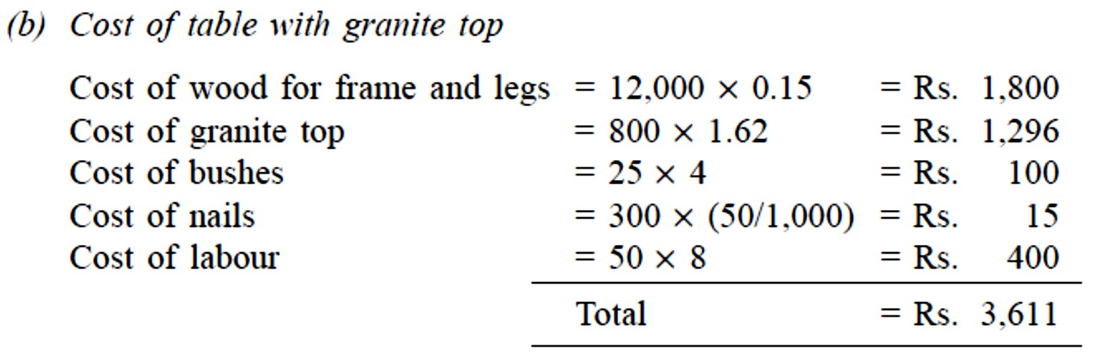
EXAMPLE 2.2

Slide 20
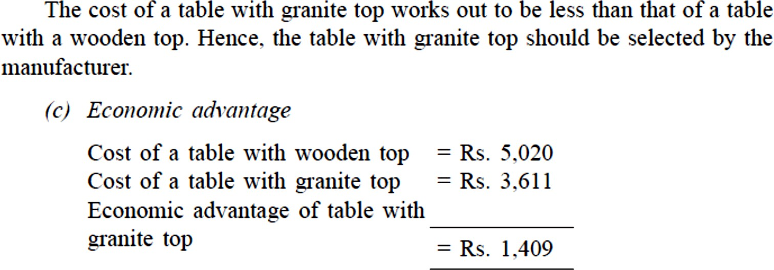
EXAMPLE 2.2

Slide 21
Design Selection for a Product
The design modification of a product may result in reduced raw material requirements, increased machinability of the materials and reduced labour.
Design is an important factor which decides the cost of the product for a specified level of performance of that product.
The elementary economic analysis applied to the selection of design for a product is illustrated with two example problems.

Slide 22
EXAMPLE 2.3
Two alternatives are under consideration for a tapered fastening pin. Either design will serve the purpose and will involve the same material and manufacturing cost except for the lathe and grinder operations.
Design A will require 16 hours of lathe time and 4.5 hours of grinder time per 1,000 units.
Design B will require 7 hours of lathe time and 12 hours of grinder time per 1,000 units. The operating cost of the lathe including labour is Rs. 200 per hour.
The operating cost of the grinder including labour is Rs. 150 per hour. Which design should be adopted if 1,00,000 units are required per year and what is the economic advantage of the best alternative?

Slide 23
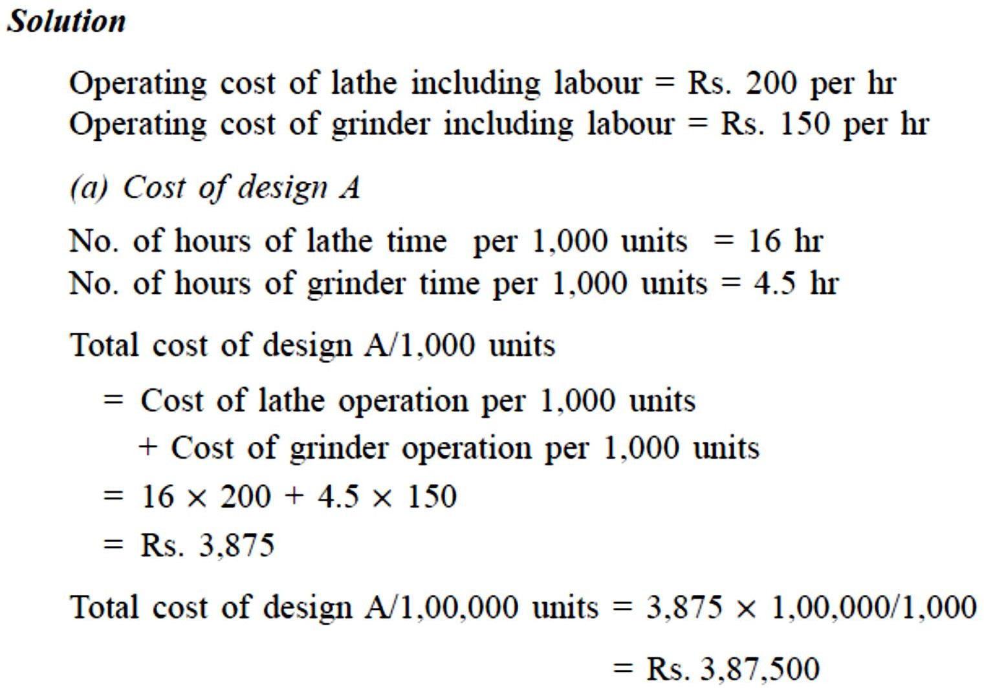
EXAMPLE 2.3

Slide 24
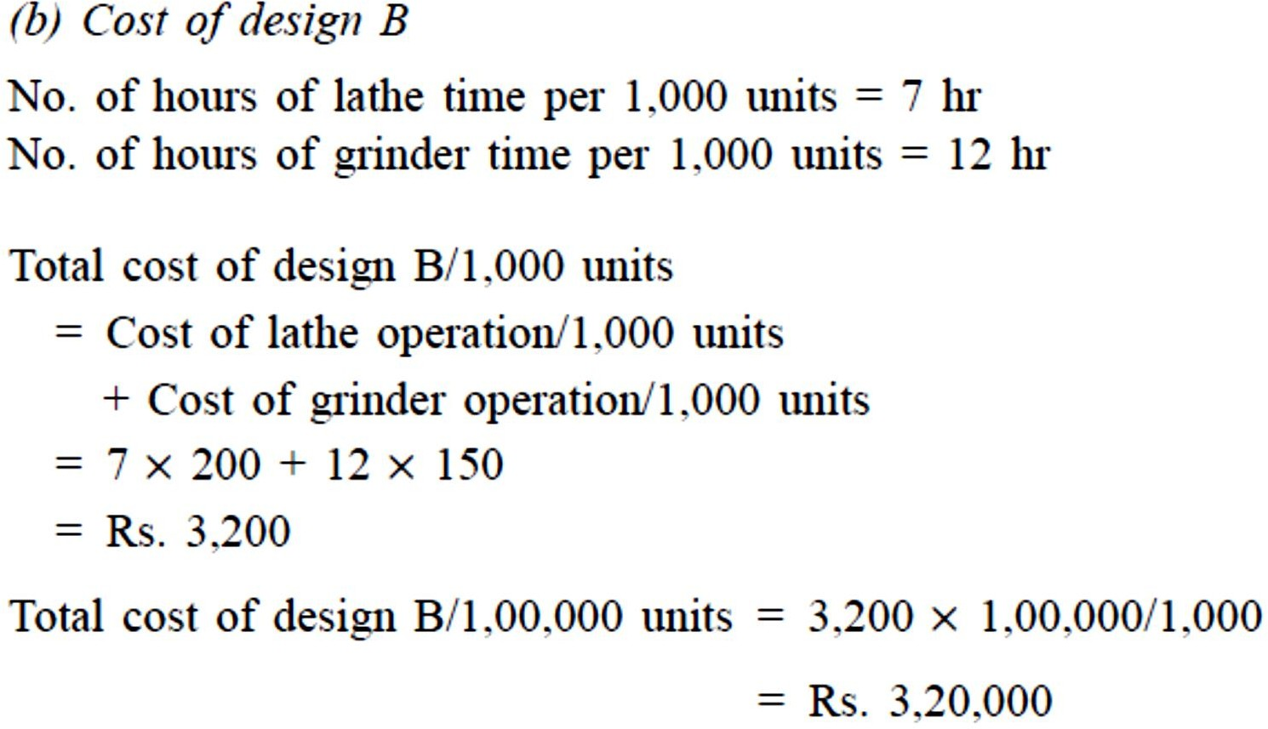
EXAMPLE(2.3)

Slide 25
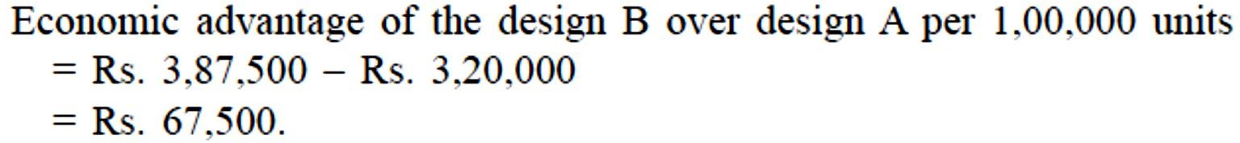
EXAMPLE(2.3)
DECISION The total cost/1,00,000 units of design B is less than that of design A.
Hence, design B is recommended for making the tapered fastening pin.

Slide 26
BREAK-EVEN ANALYSIS
The main objective of break-even analysis is to find the cut-off production volume from where a firm will make profit. Let
s = selling price per unit
v = variable cost per unit FC = fixed cost per period Q = volume of production
The total sales revenue (S) of the firm is given by the following formula:
S = s x Q
The total cost of the firm for a given production volume is given as 7
TC = Total variable cost + Fixed cost
= v x Q + FC

Slide 27
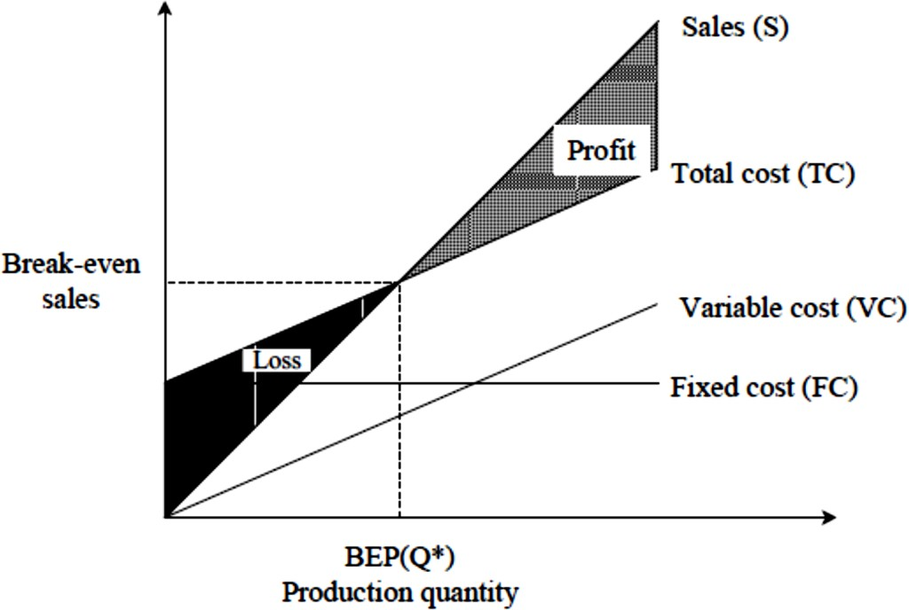
BREAK-EVEN ANALYSIS
The linear plots of the above two equations are shown in Fig. 1.3. The intersection point of the total sales revenue line and the total cost line is called the break-even point.
The corresponding volume of production on the X-axis is known as the break-even sales quantity. At the intersection point, the total cost is equal to the total revenue.

Slide 28
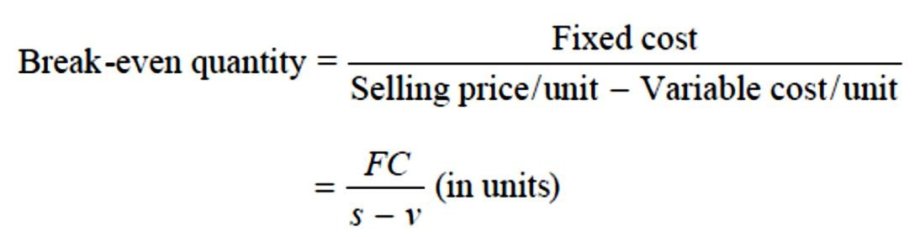
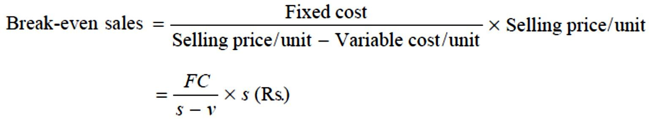
BREAK-EVEN ANALYSIS
For any production quantity which is more than the break-even quantity, the total revenue will be more than the total cost. Hence, the firm will be making profit.
Profit = Sales – (Fixed cost + Variable costs)
Profit = Contribution - fixed cost.
The formulae to find the break-even quantity and break-even sales quantity
•

Slide 29
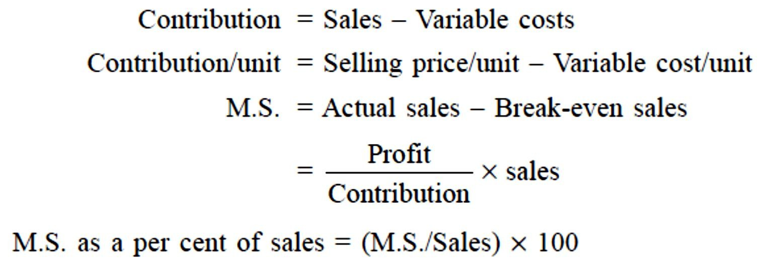
BREAK-EVEN ANALYSIS
The contribution is the difference between the sales and the variable costs. The margin of safety (M.S.) is the sales over and above the break-even sales. The formulae to compute these values are

Slide 30
Problem 2.4
Alpha Associates has the following details: Fixed cost = Rs. 20,00,000
Variable cost per unit = Rs. 100 Selling price per unit = Rs. 200
Find
The break-even sales quantity,
The break-even sales
If the actual production quantity is 60,000, find (i) contribution; and (ii) margin of safety by all methods.

Slide 31
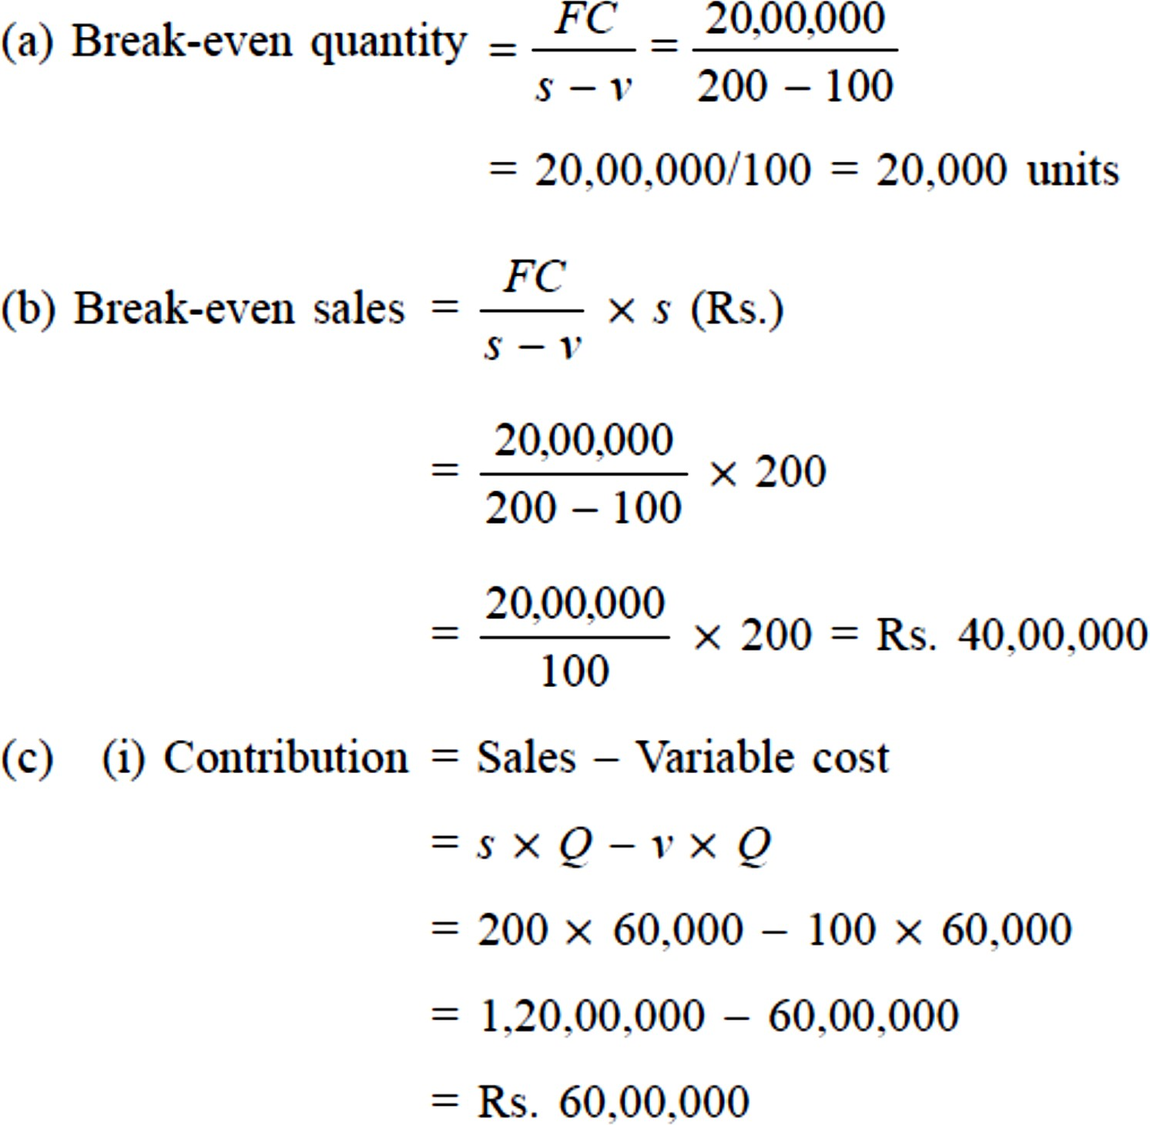
Problem 2.4
Solution

Slide 32
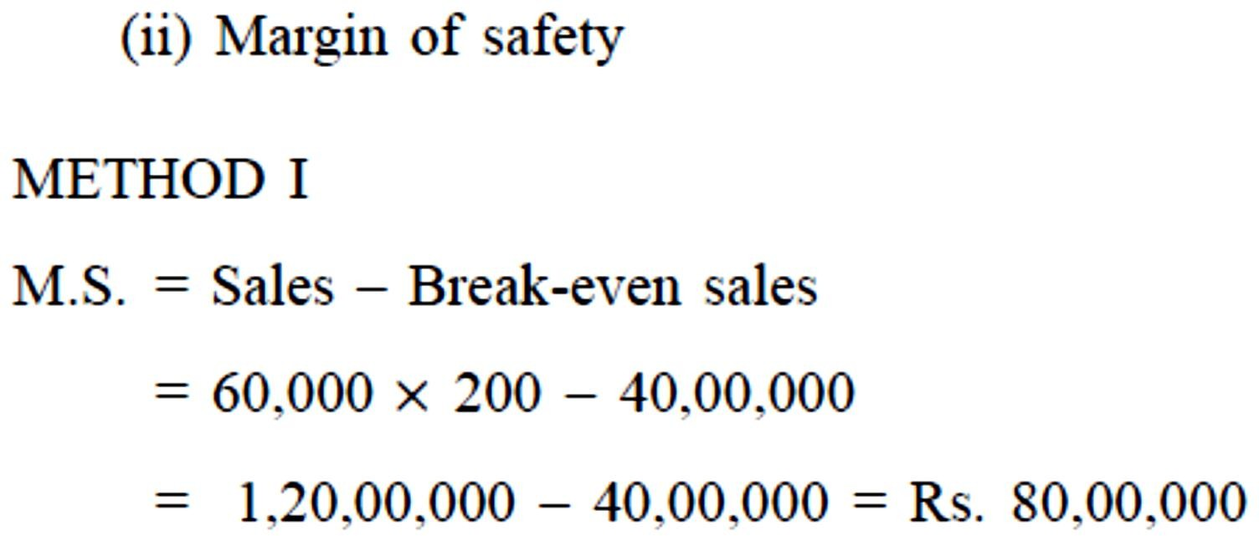
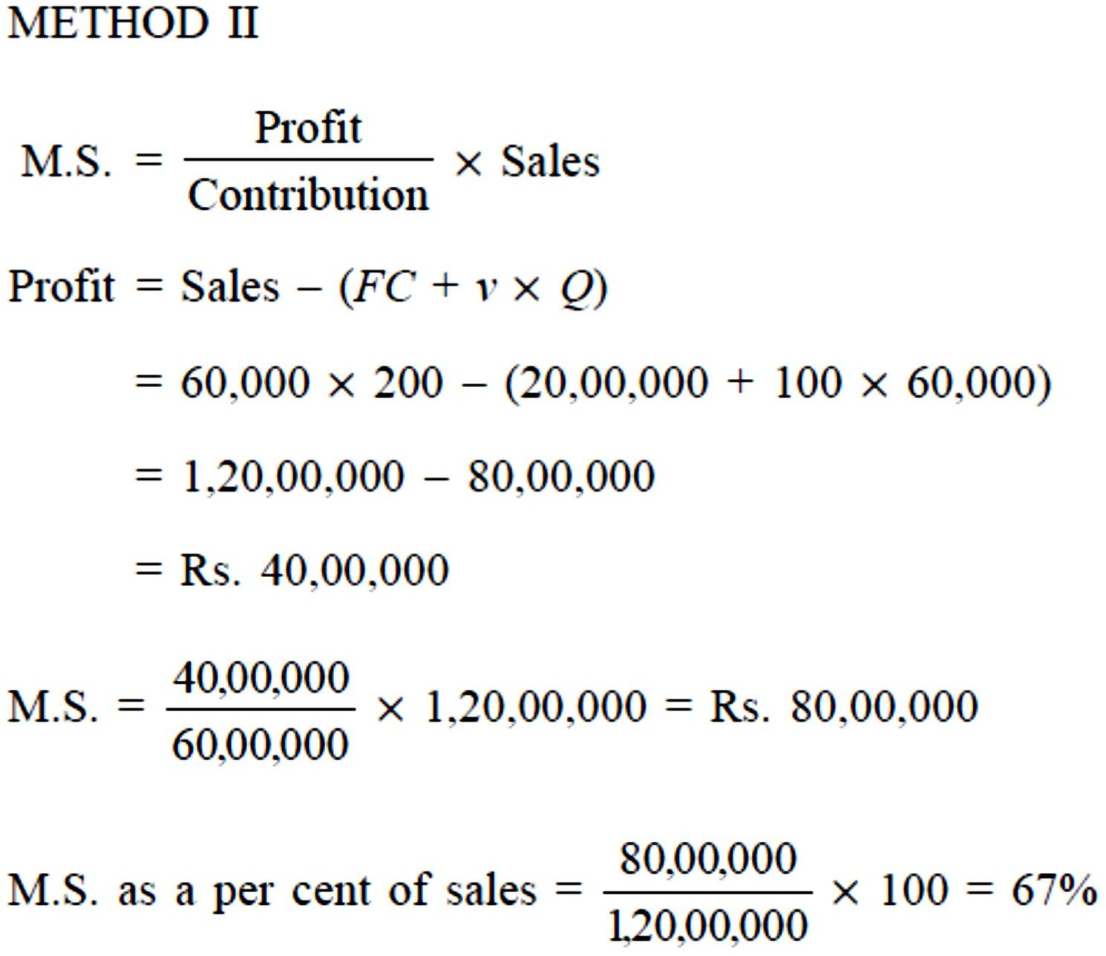
Problem 2.4

Slide 33
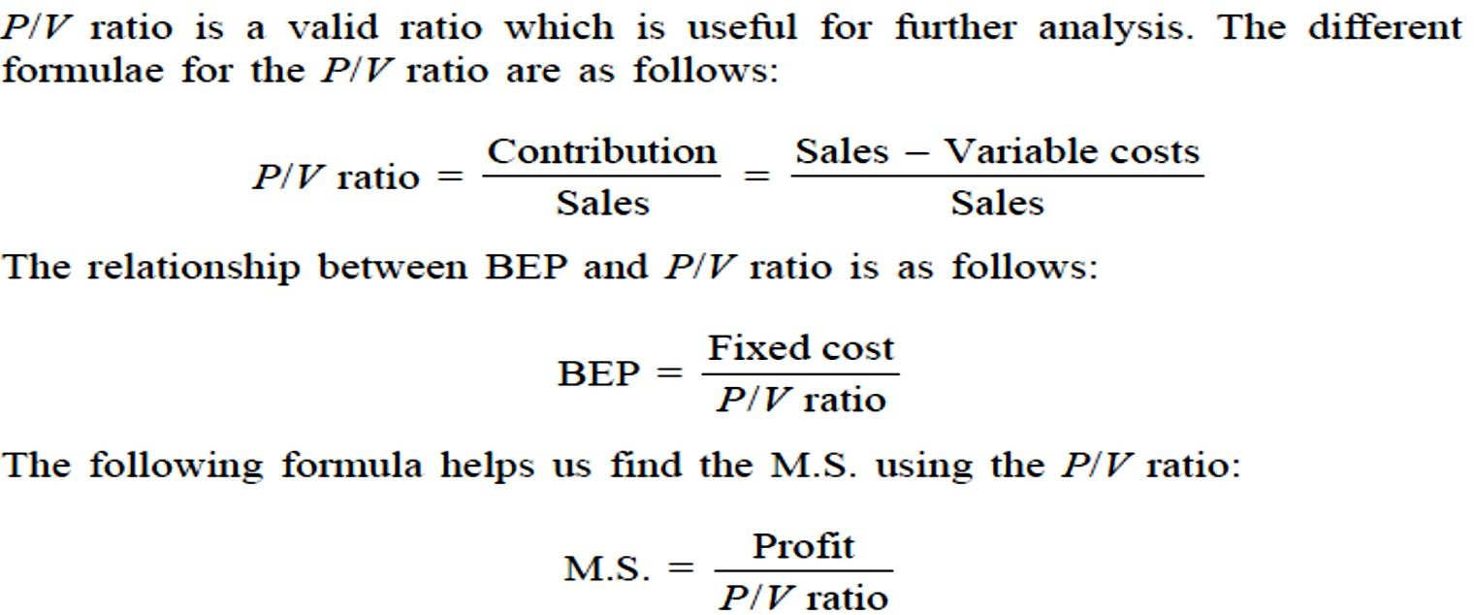
PROFIT/VOLUME RATIO (P/V RATIO)

Slide 34
Problem 2.5
Consider the following data of a company for the year 1997:
Sales = Rs. 1,20,000
Fixed cost = Rs. 25,000 Variable cost = Rs. 45,000 Find the following:
Contribution
Profit
BEP
M.S.

Slide 35
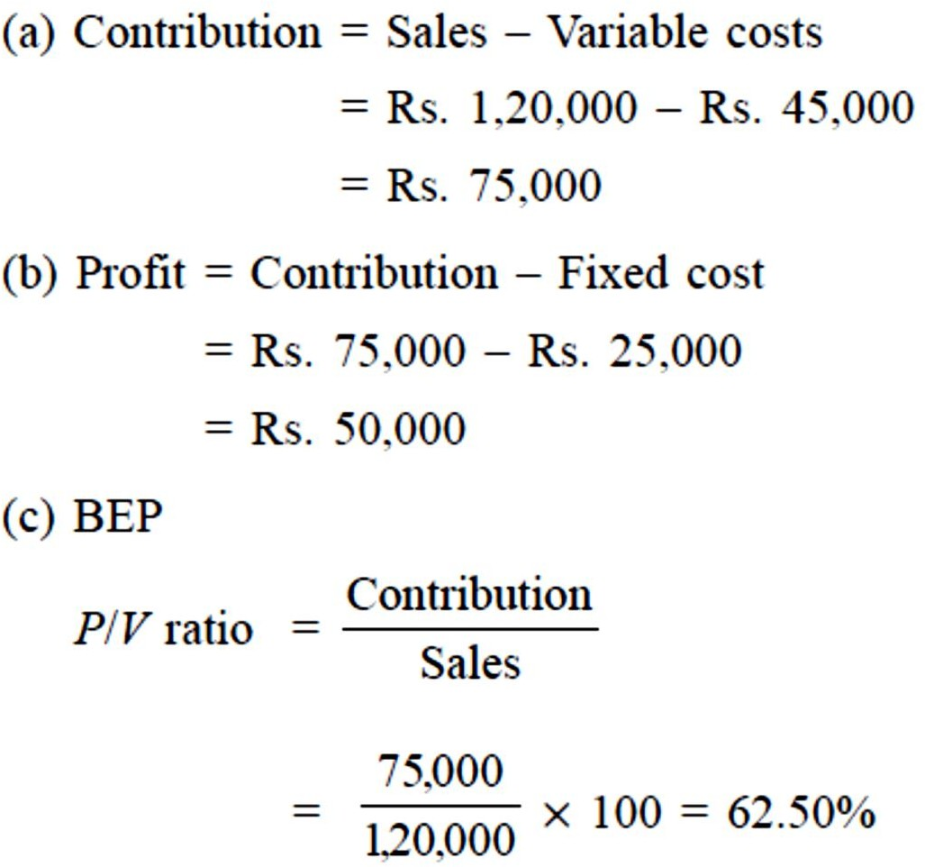
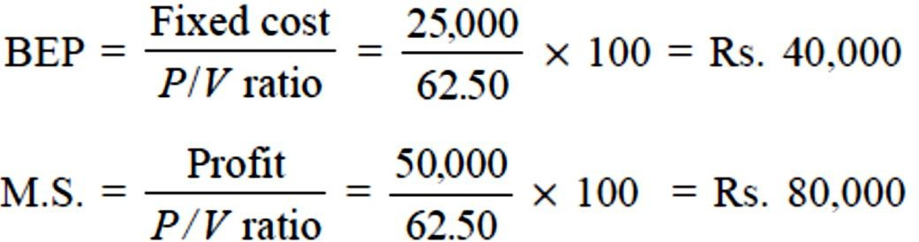
Problem 2.5 - Solution

Slide 36
